Slide 1
CMSE201 – Final Project
Simulation of Business Strategy in Agent Based Model
Hao Wang
4/21/2020

Slide 2
The Simulation of Two Restaurants
Motivations:
Using ABM to simulate the Game Theory and to solve the problem in Economics
Game Theory: Prisoner‘s dilemma
The strategy that one company want to implement have to base on another competitor's strategy

Slide 3
Agent Based Model
Background:
Agent: 64 Customers in a town, we separate the total 64 people in three categories, which represent customer's preference in these two restaurants.
1: people very like to eat in Restaurant A, no matter the marketing strategy other restaurant used to attract more customers, showed in white.
0: people very like to eat in Restaurant B, no matter the marketing strategy other restaurant used to attract more customers, showed in black.
(0-1): In this interval, people are likely effected by different marketing strategies and by their friends
This town only has two restaurants: A and B
Rules:
If all friends around a person to eat in same place, the person will have more chance go to that same restaurant.
If one restaurant dropped their price in food to a very low point, the customer will choose to eat more times in this kind of restaurant.

Slide 4
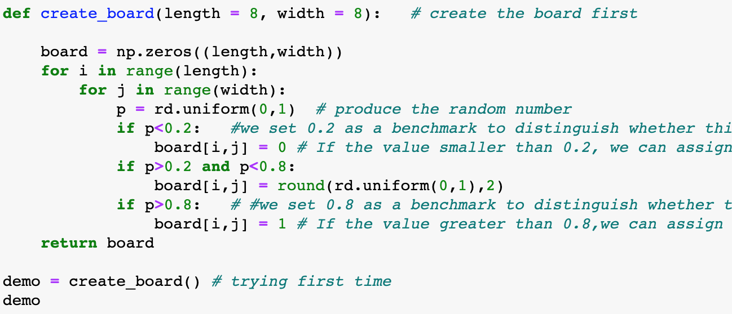
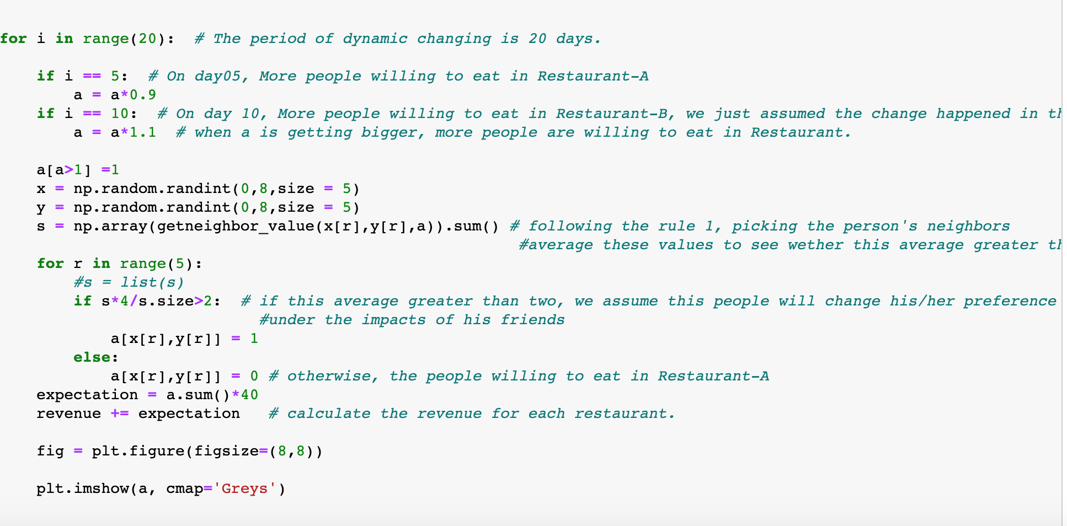
Code

Slide 5
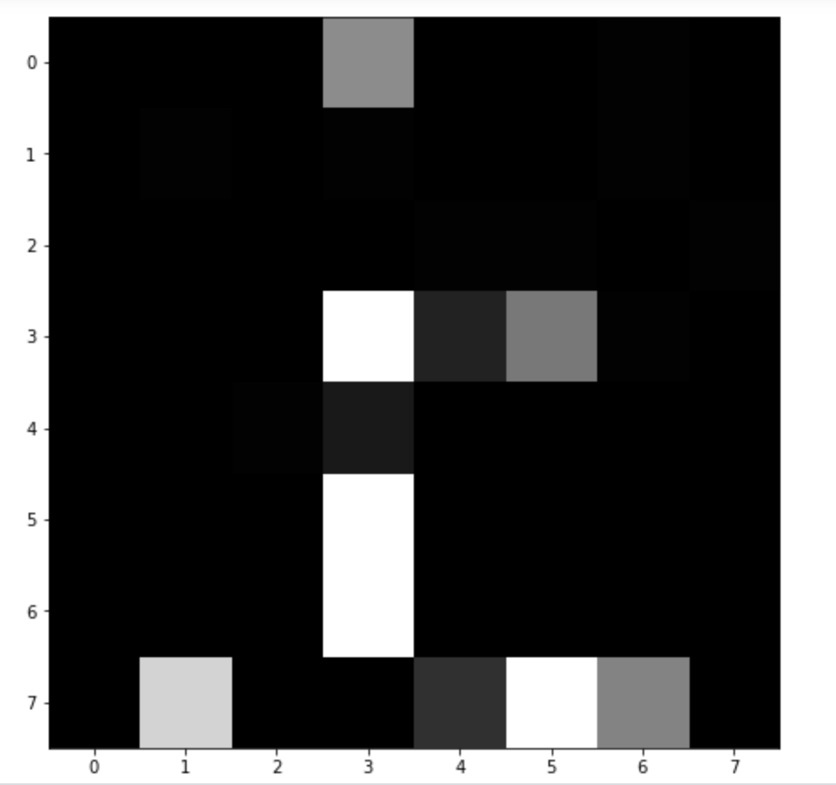
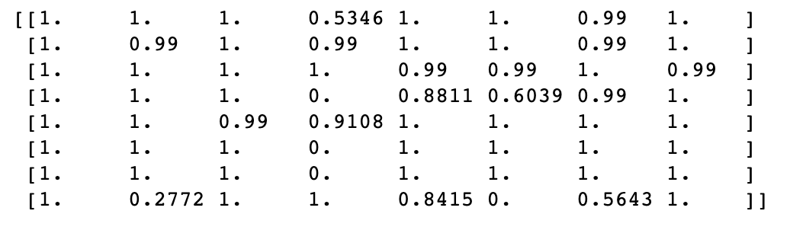
Results
After running 20 days and implementing two rules, we can find the most of area has been taken by black area, which represented restaurant A.

Slide 6
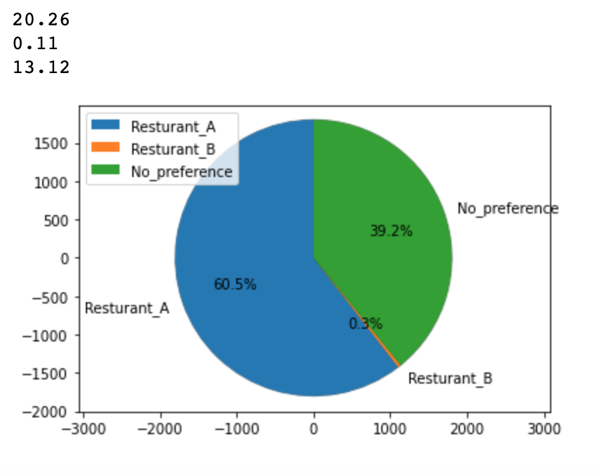
Result
Based on this results, I found that there are 96.3% of people are wiling to eat in Restaurant A and there are only 1% of people are willing to eat in Restaurant B. There are still 3% people did not change their preference after adding this e two rules.
Notes: The result may changed based on different run, because the number are randomly produced in the beginning.

Slide 7
Discussion
Small changes in random number in the beginning stage could lead a huge difference in the end.
Two rules could reinforce people’s behaviors without other player’s response
If there are more people initial like to eat in a restaurant may based on some random facts such as location or taste, and then the suitable marketing strategy and the effects of social need or the impacts of friends will lead more people to eat in this restaurants.
In the next time, I will add more variables in this model such as location, types of foods and size of restaurant. And I could to insert the more information in game theory into this model to see what is the best strategy for restaurants, and finally let this two players automatically play around.

